Slide 1
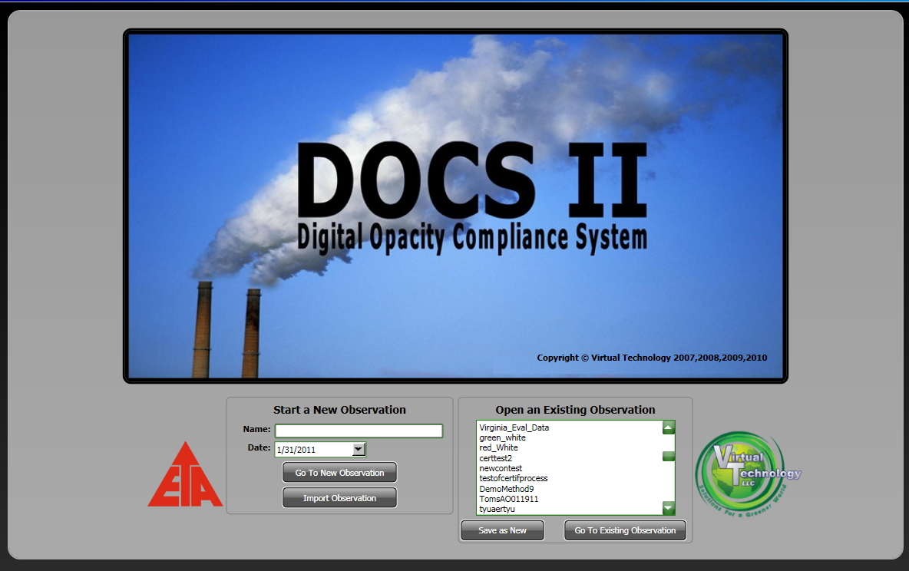
Visible Emission Measurement
Digital Opacity Compliance System
the Next Generation of Opacity Measurements
Shawn Dolan
888 872 3836
Shawn.dolan@virtuallc.com
03/09/2011

Slide 2
Agenda
ASTM D7520 Update
DOCSII Walk Through and Discussion

Slide 3
ASTM D7520 vs Method 9
ASTM D7520-09
EPA Method 9
Device (Camera, Computer, Software) 300 reading (6 runs) certification
Operator Training
  8 hour course
  50 plume certification
  +/- 7.5% overall and 15%
Certification Duration 3.5 yrs
Operational Conditions
  Unlimited backgrounds
  Unlimited weather conditions
Person only devices not applicable
Operations
  8 hour course
  50 plume certification
  +/- 7.5% overall and 15%
Certification Duration 6mo
Operational Conditions
  Unlimited backgrounds
  Unlimited weather conditions
Standards are essentially the same performance criteria

Slide 4
ASTM D7520 Update
Work Group for Standard Maintenance (Shawn Dolan, Chairman)
Proposed a change to the released version in support of Bias section Update
Will be proposing additional modifications in the upcoming meeting (April, 2011)
  RGB Qualification Testing
  Certification testing background variation
ASTM D7520 is constructed with forensic credibility in mind!

Slide 5
DOCSII Update
DOCSII Certified According to D7520
  Camera Model - Canon Powershot G11 (6 runs, 300 images,
  Double Blind process, all attempts tracked)
  Analysis Module - DOCSII Versioned Analysis Module
  Reporting Module - DOCSII Versioned Reporting Module
  Self Test on-board to ensure changes in hardware or OS do not
  impact configured modules.
DOCSII sold into multiple (nuisance) Environments
Hill Air Force Base approved by the EPA for site use of DOCSII as equivalent alternative to Method 9 for all visible emissions.
EPA had limited hands-on with DOCSII, and is working the adoption of ASTM D7520, with broad applicability
With Pre-certified camera and software…One run and DONE is the Goal!

Slide 6
DOCSII Walkthrough

Slide 7
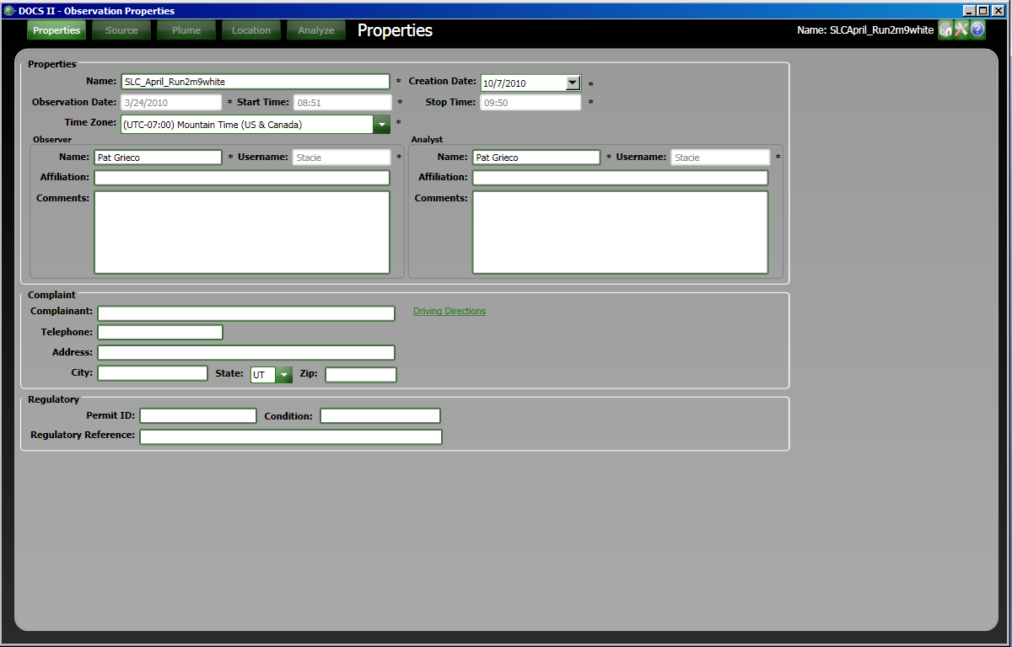
Properties
Dates/Times are filled in from images
Required Fields are identified with *
Observer and Analyst two traceable functions
A link is provided to Mapquest for driving directions as applicable.
Notes:
As we go through the application, we will highlight things that support efficiency and credibility.
Dates and times from the image header are used to fill in information normally provided by the observer. Serves to save time, and more credible. In fact, DOCSII derives a lot of its forensic credibility from using the date and time from the image as we will see later with some of the Location functions.
Required fields are done differently in DOCSII than in most applications. The asterisk alerts users to the fact that a field is required. However, we do not stop progress. Many times information may not be immediately available, however the user can move on with information they do have. The required fields are enforced later when the user attempts to “Finalize” an observation.
Based on numerous requests, we allow organizations to identify field observers (camera operators) and Analysts as separate functions, and we track who each is associated with a VEO set.
Also based on request, we included a simple driving directions function which uses the address provided to bring up a map and directions. In a future release we will do this with a GPS coord…called geocoding, in cases where an address does not exist.

Slide 8
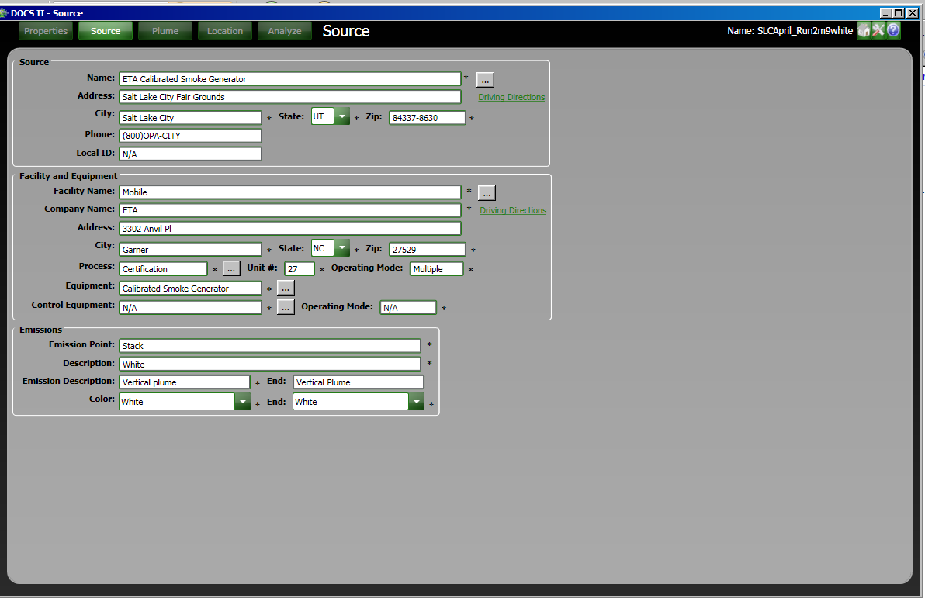
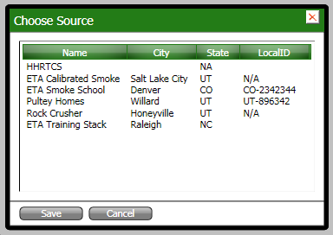
Source
Re-usable pick list data
Notes:
Here we see the ability to re-use data previously keyed in…we also do this a little differently in that we do not force pre-population of pick lists, so the lists are developed as you go…lists will be exchangeable between licensees.

Slide 9
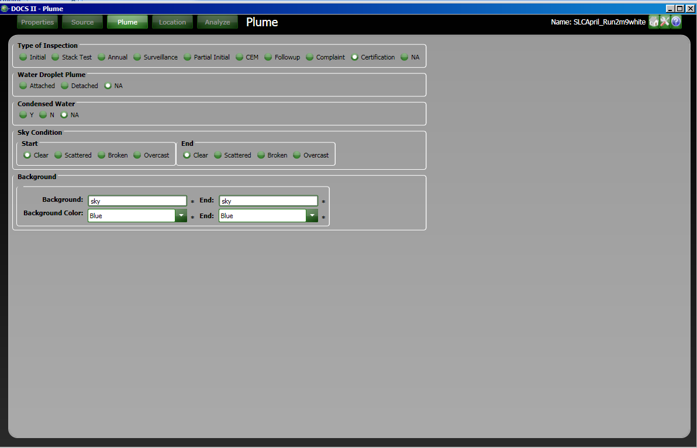
Plume
Radio Groups for fast characterization
Notes:
Radio groups are best here as they allow only one selection form a short list

Slide 10
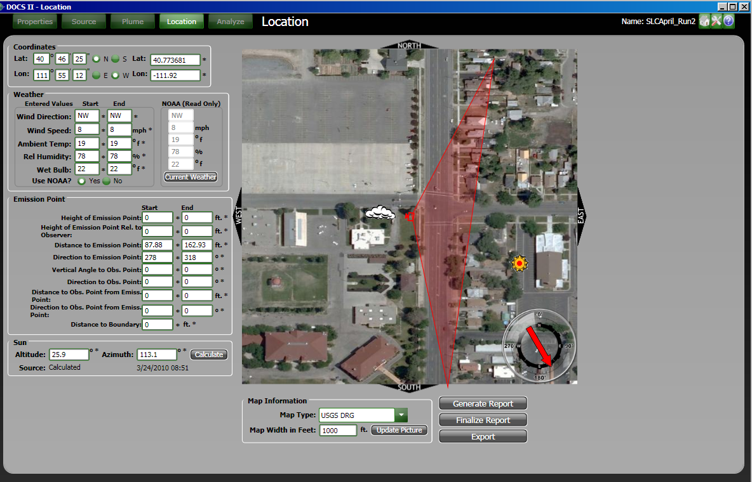
Location
The current weather for
the lon/lat coordinates is
retrieved when pushing
this button. Once the
weather is entered the
compass indicates wind
direction.
Digital Layout “Sketch”
A report is generated
using all of the information
in the observation.
Locks Data. Checks to ensure all required fields are entered.
The position of the sun is
Calculated in two modes. 1) Survey
2) Observation
Allows observation to be exported, and imported by another DOCSII certified user.
An aerial photo is retrieved using the coordinates. The Map width can be entered to zoom in or out on the observer’s position.
Notes:
With GPS coordinates of the observer, weather data can be obtained from NOAA. As well, the user may choose to overwrite based on localized conditions. When the weather fields are populated, the compass showing wind direction appears on the digital layout sketch.
Utilizing the previously entered GPS points, update picture button is pressed filling in the digital layout sketch with a satellite image of the area.
Again referencing those same GPS points the user clicks the calculate button, and based on their location, and time of day, the sun tables from the Naval observatory are referenced, and the sun placed on the digital layout sketch. There are two modes supported 1) Survey-used when a user wants to determine if they are legal to start an observation at a specific location…it uses the GPS and the computer’s system clock to place the sun on the digital layout sketch…it is a view of the world right now. 2) Observation – used when there are images pulled in to be analyzed, and their adherence to the 140 degree cone are verified. This approach uses the GPS coords and the date time stamps from the images. The software manages these modes…the user simply references what the software provides and decides to proceed in the field, or if a set of observations remained legal throughout.
The “Cone” triangle on the digital layout sketch is placed and oriented based on the placement of the plume. The user simply clicks on the digital layout sketch to place the plume (cloud icon) and the camera icon and cone re-orient based on the required bearing to capture the image.
Reports can be generated any time to review data.
Finalize report checks to ensure the record is complete, and then locks the record from any further editing.
Export allows data to be transferred from one licensee to another (such as the instance where we have a field observer , and a different person performing the analysis on the images).

Slide 11
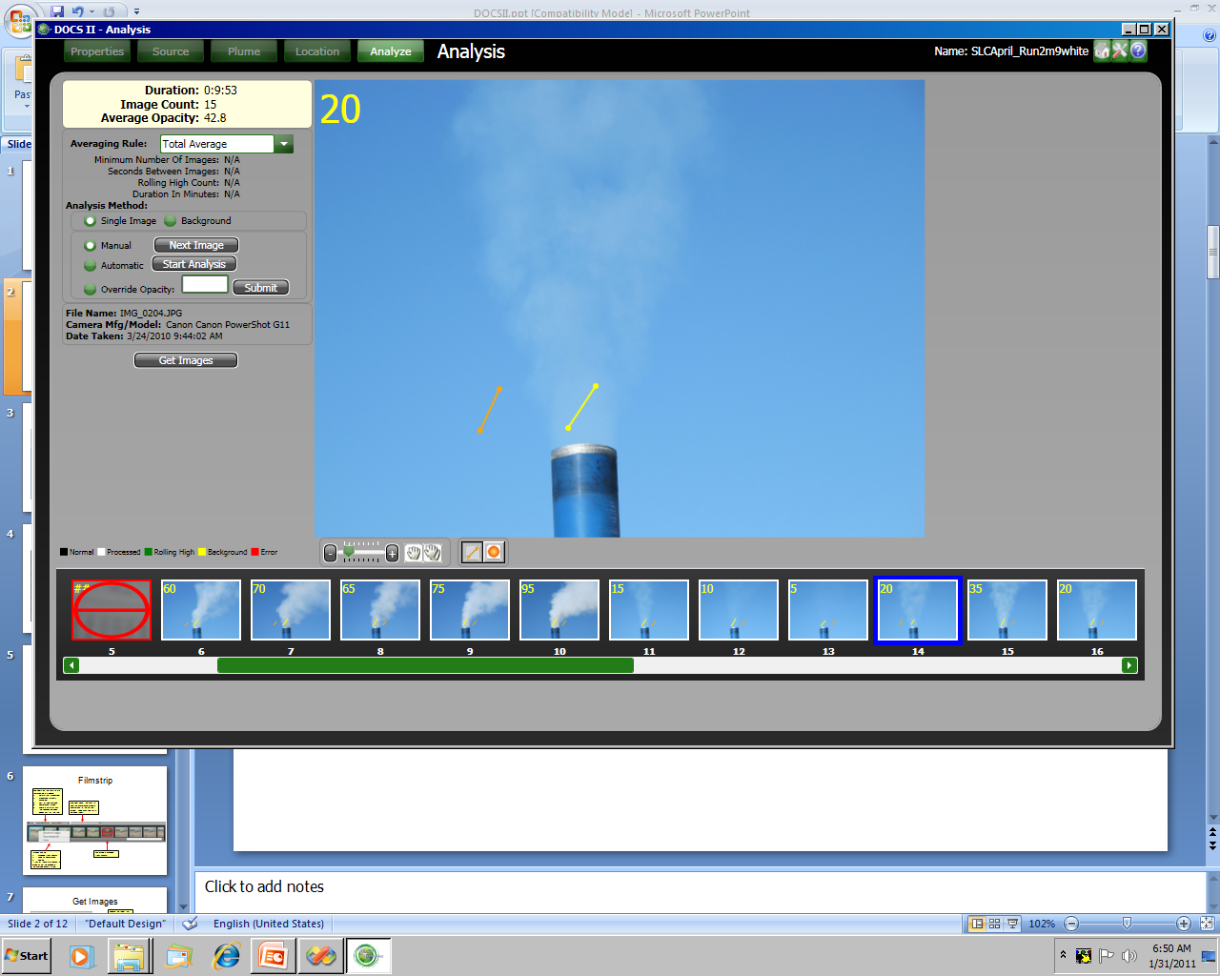
Analysis (Simple Background)
Zoom, Pan, and Plume selection tools
You may exclude an image from analysis, but still keep it with the set
Notes:
Used primarily for larger stacks that offer only sky as a background.
Draw the Yellow stick or ball in the plume, then the next in the background. Zoom in to veryify good background on days where there are clouds invovled. If you used a tripod, you can simply click the analyze button, and the software will use the first image where you placed the sticks to place all remaining sticks…this cuts the process from a few minutes to seconds.

Slide 12
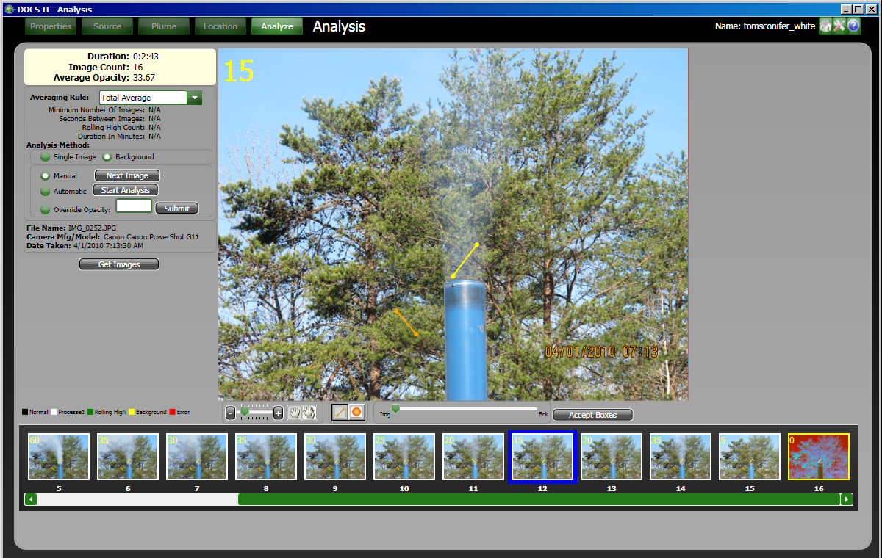
Analysis (Complex Background)
Background
Notes:
This approach is used when source has shadowed or complex background.
Select a background or Zero image. Place the sticks on the background above the emission source, then next to it away from where the plume will be. Go to each image and verify alignment with background via slider tool, click accept, and move on.

Slide 13
Analysis Tools
Statistics about the images being analyzed
Rule being applied (customizable to meet any jurisdictional specific rules)
Analysis Method:
Single = Simple Background
Background = Complex Background
Manual = User Draws
Automatic = User Draws Once, DOCSII draws the rest
Override = User who chooses to put in values of their own
Allows user to pull images from a network, local machine, or device (camera)

Slide 14
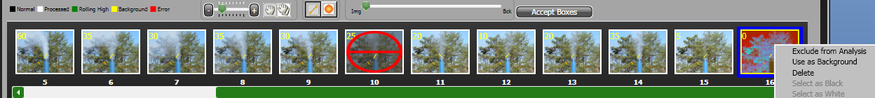
Analysis Tools
Zoom, Pan, and area selection tools (bar bell or circle)
The colors on the filmstrip are
represented in a legend.
Normal (Not processed)
Processed (Opacity calculated)
Part of Rule average
Background Image
There is an error with the seconds between images part of the rule.
The slider allows the user to
view the background image in
comparison to the current
image. Sliding back and forth
between them.
Images can be:
Excluded from Analysis
Used as Background
Deleted
If any of these are chosen the
image will not be included in
the average opacity rating.
This image is excluded
from analysis.

Slide 15
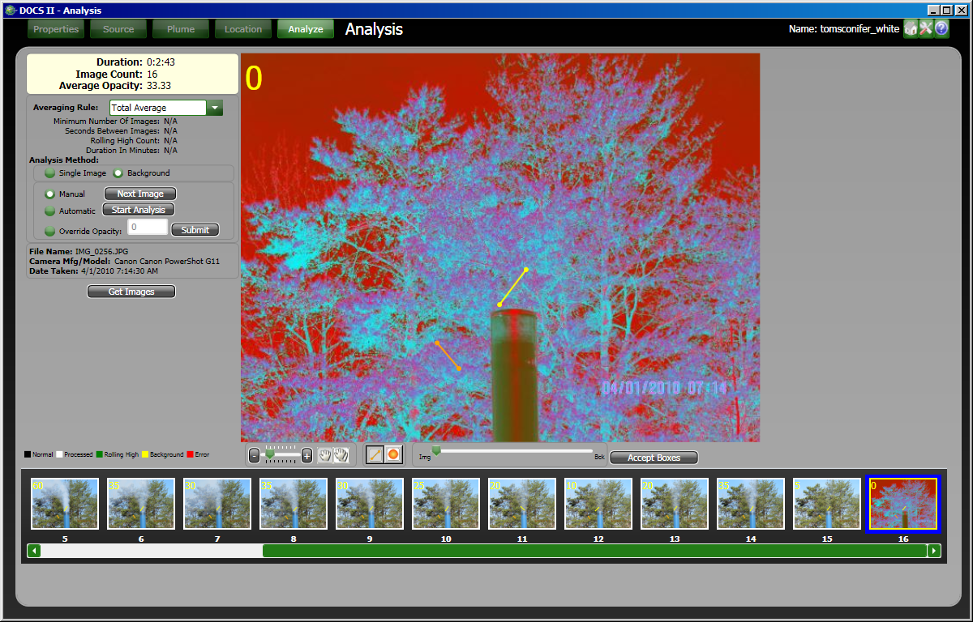
Whats New This Year
Background displays as a 2D rendering which aids in selecting a suitable background, and for image alignment.
Notes:
This approach provides visual aid so you don’t use heavily shadowed areas or areas significantly out of the same plane for comparison.
In this image the purple areas indicate good backgrounds to utilize. Thus areas that are red, or that have significant aqua in them are not good backgrounds.

Slide 16
Averaging Rules
Rule Name | Minimum Number of Images | Rolling High Count | Seconds Between Images | Comments
Method 9 | 24 | 24 | 15
Dust | 4 | 4 | 5
Continuous Fugitive | 240 | 12 | 15
ODR | 2 | 2 | 5
Total Average | N/A | All | N/A

Slide 17
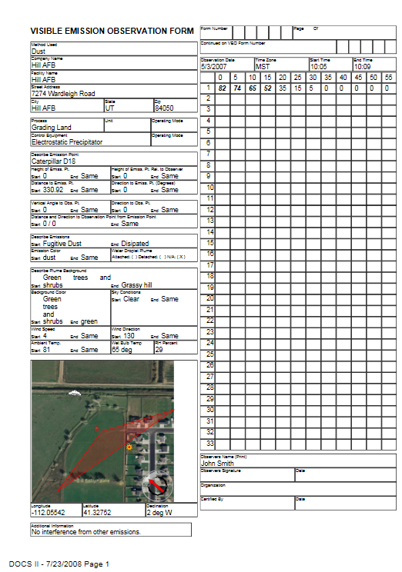
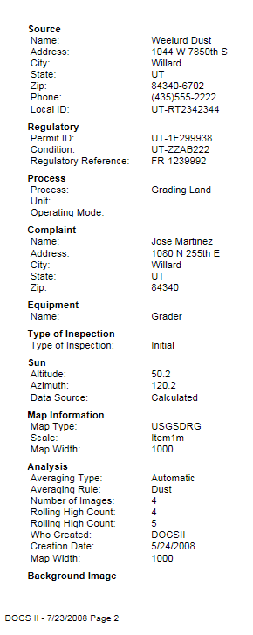
Report

Slide 18
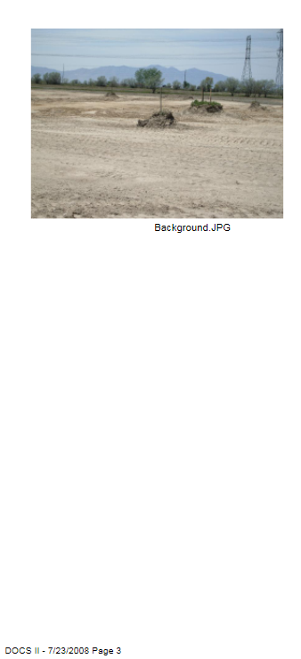
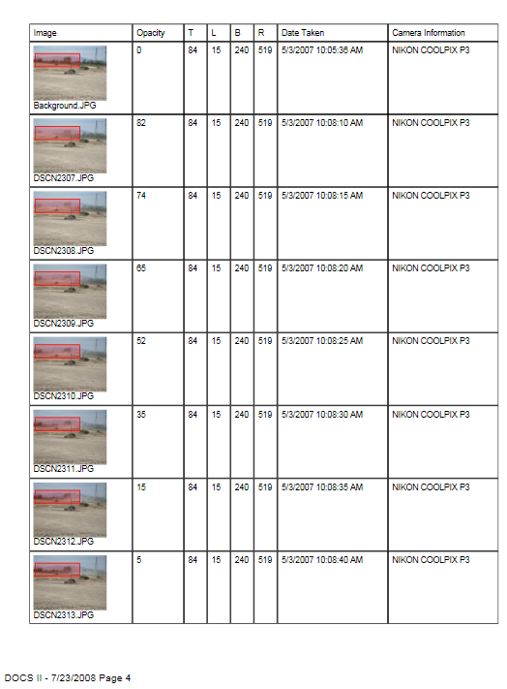
Report

Slide 19
Questions ?
Digital Opacity Compliance System
the Next Generation of Opacity Measurements
Shawn Dolan
888 872 3836
Shawn.dolan@virtuallc.com

